Slide 1


Gathered Data & Beginning MongoDB
By Juan Villegas
3/22/2023

Slide 2

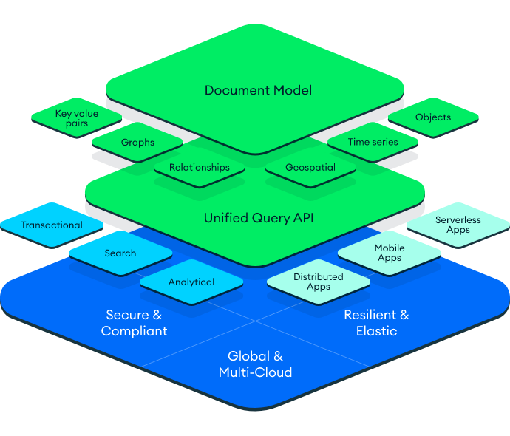

Background
Real Estate Companies/Realtors: deal with the buying, selling, management, or investment of real estate properties
MongoDB & MongoDB Atlas:
MongoDB: a document-oriented database program. Classified as a NoSQL database, It stores documents in JSON-like format.
MongoDB Atlas: a fully-managed cloud database that handles all the complexity of deploying, managing, and healing your deployments on the cloud service provider of your choice (AWS , Azure, and GCP)
Atlas CLI: a command line tool for MongoDB Atlas. It helps create, manage, and automate MongoDB Atlas resources from your command line.

Slide 3
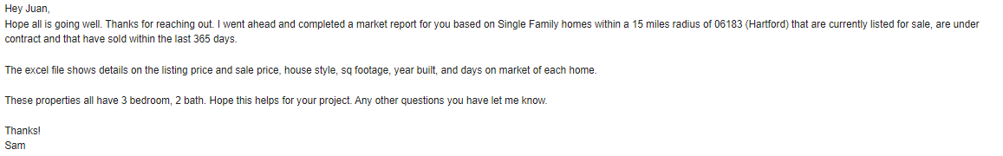
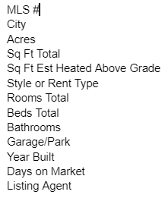
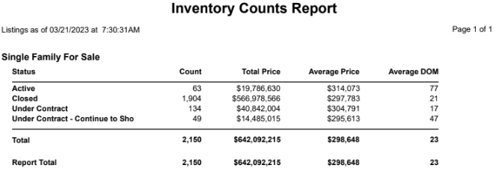
Progress: Gathered Data (Realtor)
After reaching out to countless Realtors, one specific realtor got back to me & gave me the follow data.
Data is limited:
Only Single-family homes
2 bathrooms
3 bedrooms
Reached back out to Realtor hoping to get a less limited data set.

Slide 4
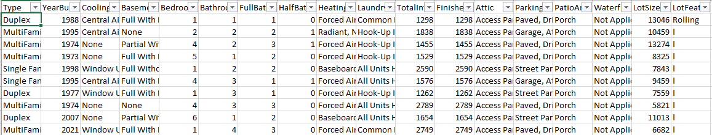
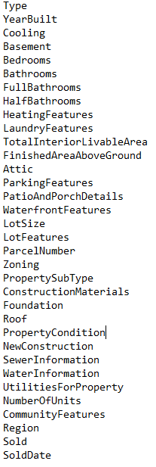
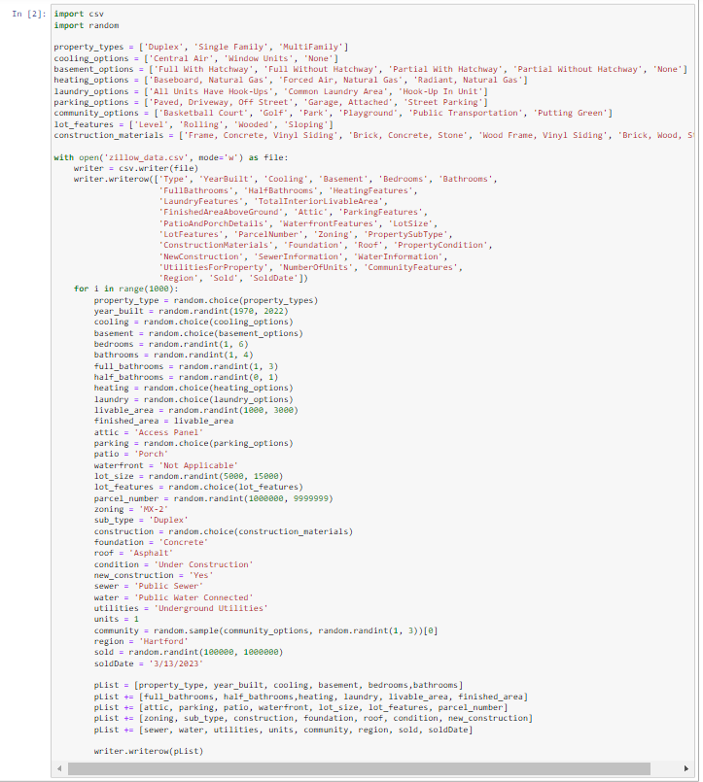
Progress: Gathered Data (Fake Data)
Before reaching out to realtors, chatGPT and Dr. Dancik helped me create some fake data using pythons random and csv libraries.

Slide 5
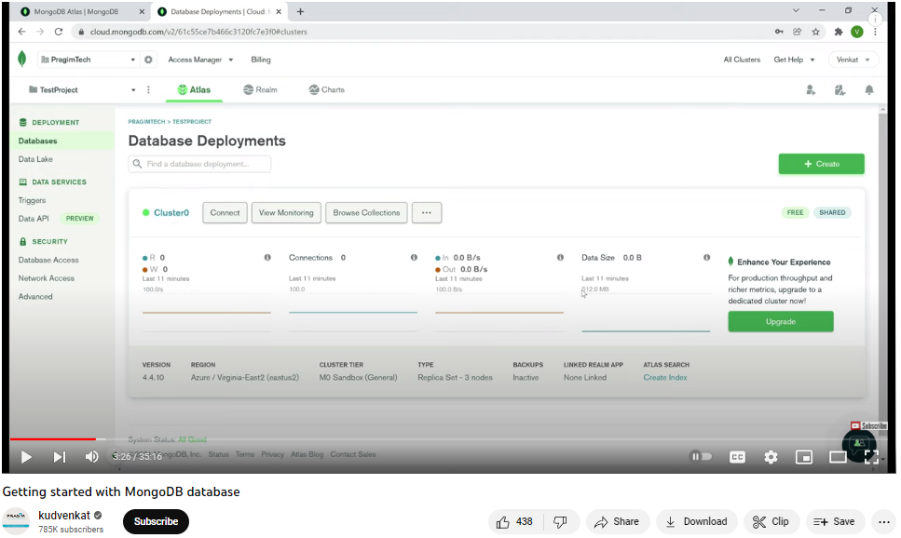
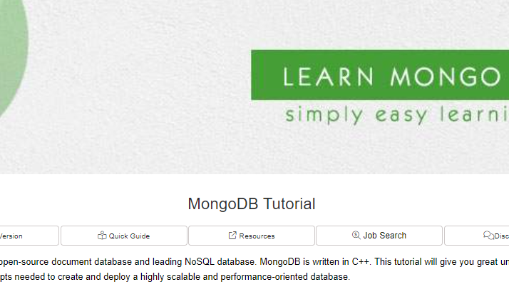
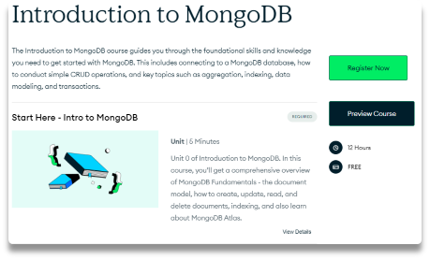
Progress: Moving on to MongoDB
Youtube Tutorials
Online Tutorials
MongoDB Official Course

Slide 6
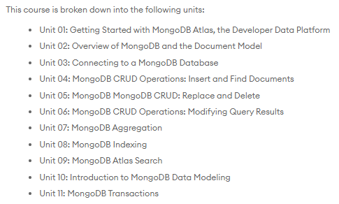
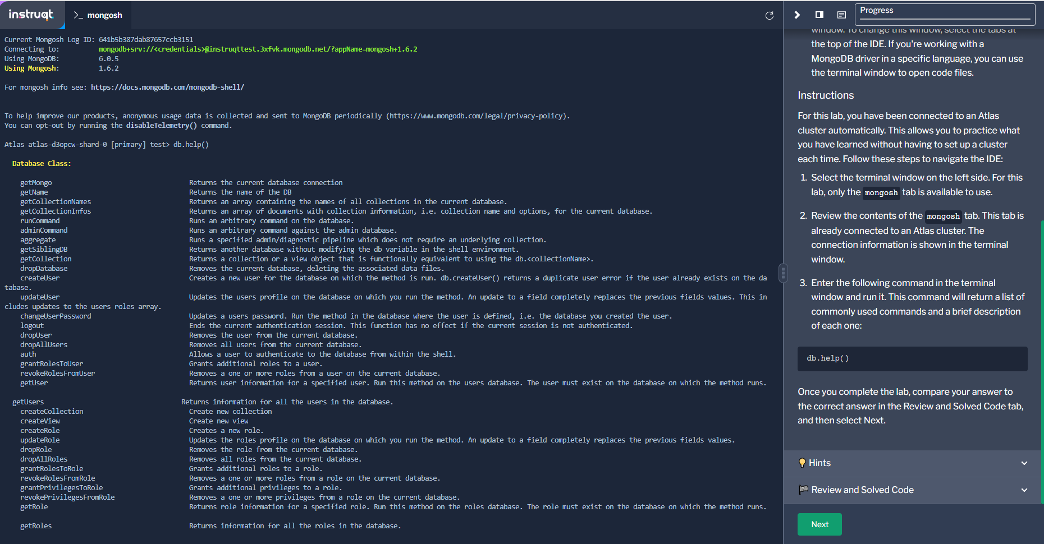
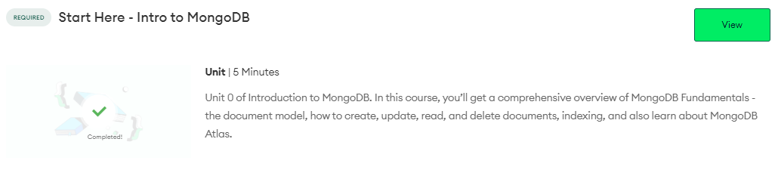
Progress: Intro Lecture of MongoDB
Intro Lecture
Overview of what will be covered
Intro to virtual IDE

Slide 7
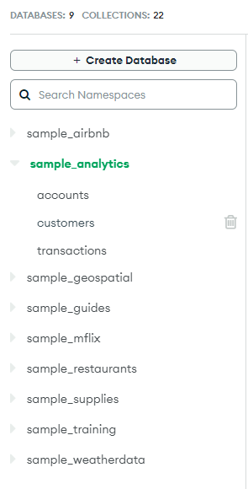
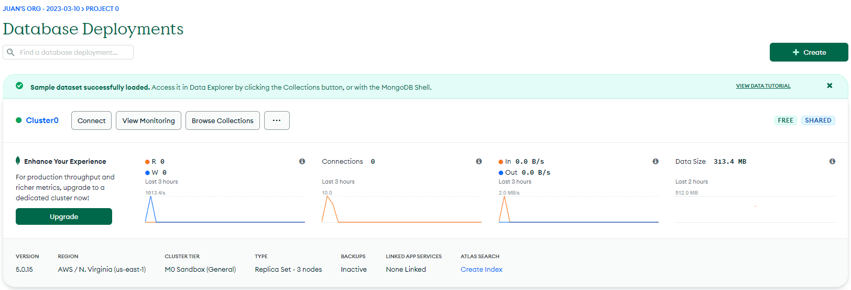
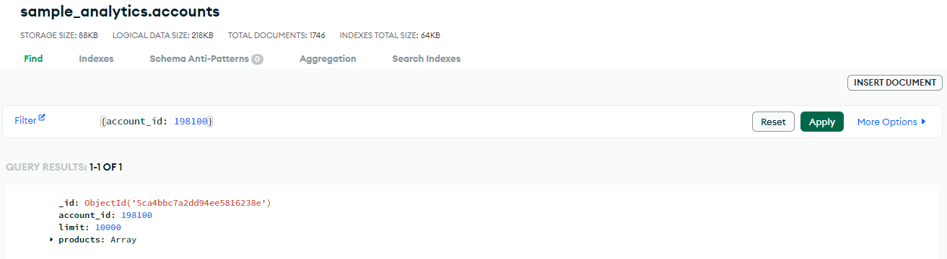
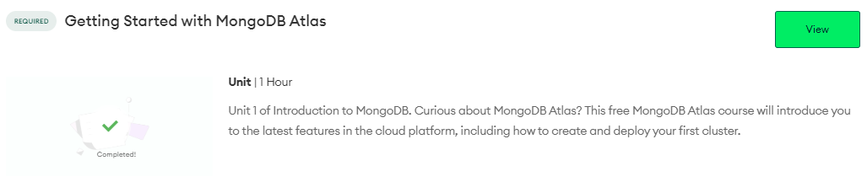
Progress: Getting Started with MongoDB Atlas
Created a MongoDB account
Used the Sample database
Began learning to filter on this database

Slide 8

Next Steps:
Finish The MongoDB Crash Course
Put Housing Data in MongoDB
Query and play around with Housing DB

Slide 9
Questions
Should I keep trying to get the data that I want?
Do you see any learning curves I might come across while learning mongodb?
Do you recommend I utilize the GUI for Mongo DB or use the Atlas CLI (Command Line Interface)? Why?

